Slide 1

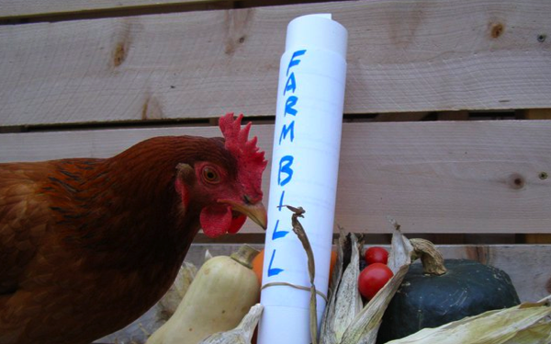
2011 Farm Bill
And how we feed the World

Slide 2

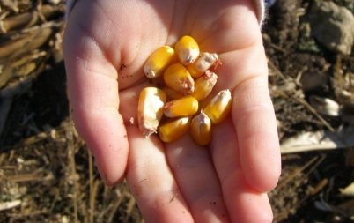
Potomac Politicians vs.
Farmers and Ranchers
The controversy between the green leaf producers, the small farmers, the grain producers, the livestock producers, the fruit producers, the water usage issues, the flooding issues, the ethanol producers, the dairies and milk producers, the world demands, etc.

Slide 3
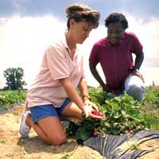

They continue to try to eliminate small local producers with "rules".
Have you heard of NLGMA? Its the
National Leafy Green Marketing Agreement, and its a proposed national food safety rule for leafy greens. This update from the National Sustainable Agriculture Coalition provides the perspective of many farmers that are not pleased with the proposed rules.

Slide 4
How do farm groups feel about USDA's proposed rules to limit the economic power that livestock packers and processors have over farmers and ranchers?
National Farmers Union supports these efforts and is upset that some in Congress are trying to put a halt to these rules. The Pork Producers and other groups want the rules to go away

Slide 5
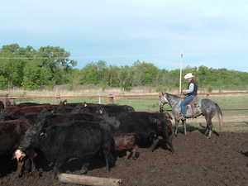
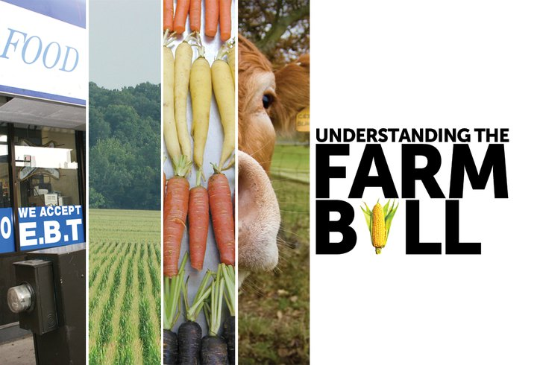
And invasion of Personal Rights
One-size-fits-all regulations

Slide 6
“This is the first step in preventing an unprecedented government invasion into the private marketplace. Big government has invaded banking, healthcare and more. The last thing we need is the federal government setting up shop on cattle ranches throughout the country,” said Bill Donald. NCBA President Bill Donald, a Melville, Mont. rancher “The marketplace works well without government intrusion and this legislation is proof that many in Congress feel the same way.”

Slide 7
Many were excited to see the Biomass Crop Assistance Program become part of the 2008 Farm Bill, figuring it was a way to push biofuels beyond corn ethanol. Unfortunately it has too much of a focus on corn stove and wood stove- not really pushing the envelope. The program may not get renewed in 2012.

Slide 8
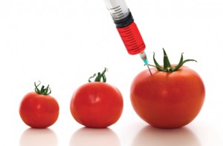
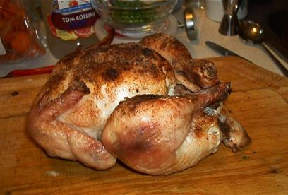
Genetically Modified Crops
Injected Meats

Slide 9





In every link of the new global food chain, agriculture has become more intensive, larger in scale, and more environmentally and socially unsustainable.
While the demand for water is on the rise, the supply is shrinking. Water-intensive agriculture, population growth, industrial pollution, breakneck development and other ecological threats are depleting freshwater supplies.

Slide 10
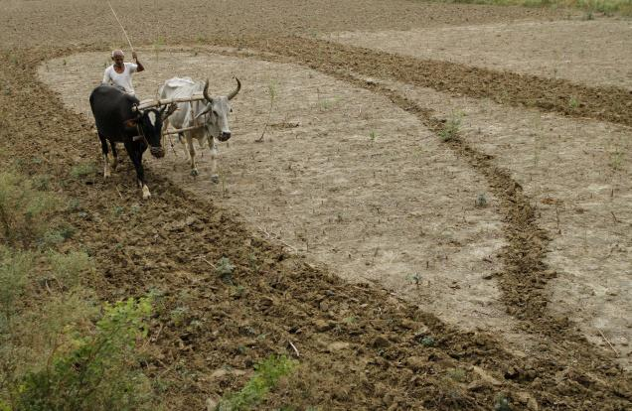
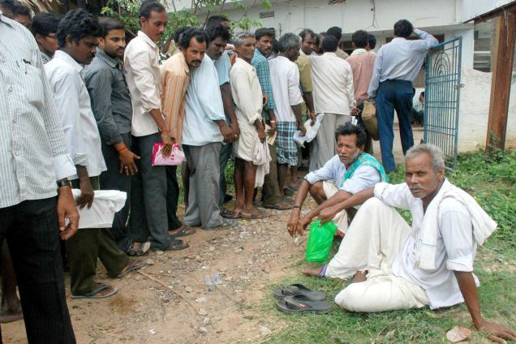
Hindu… India
A farmer ploughs his field after rains in Allahabad. The India Meteorological Department has forecast less than normal rains this year.
The US Will have to send food to India.
Shortage of seed has become a major concern for farmers of Srikakulam district. Hundreds of villagers queued up before the seed counters across the district.

Slide 11
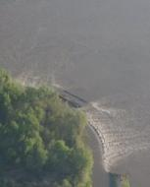
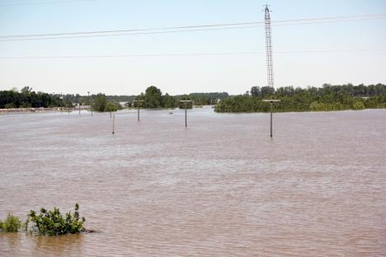
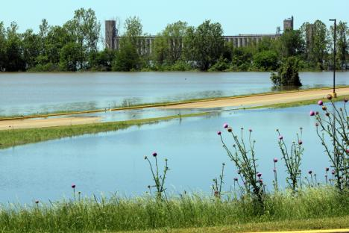
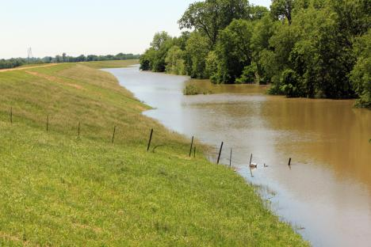
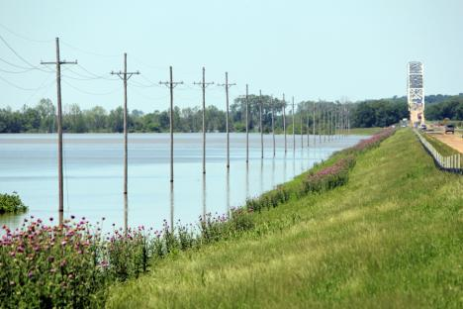
Five new NRCS projects to protect Arkansas’ Mississippi River Basin
Arkansas NRCS office
Jun. 21, 2011 11:36am
Along US Hwy 49, The Mississippi spread out for 100 miles

Slide 12
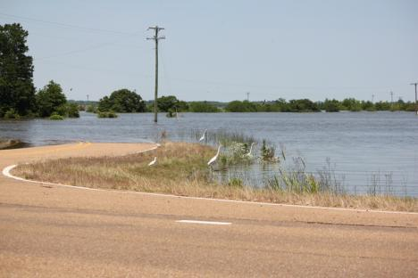
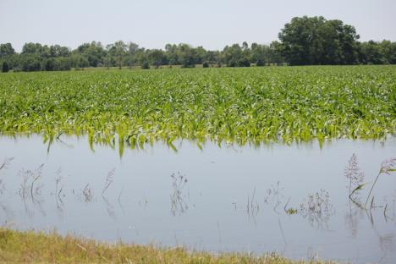
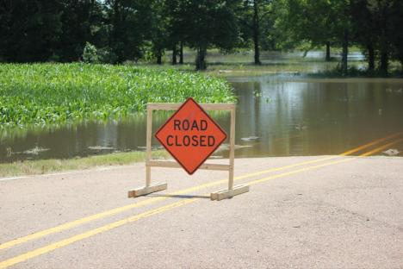
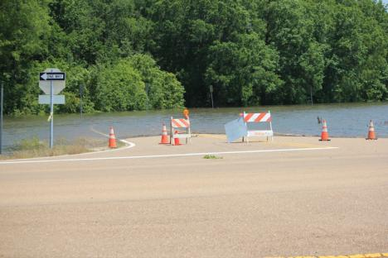
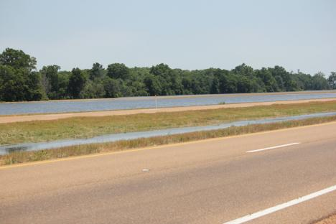
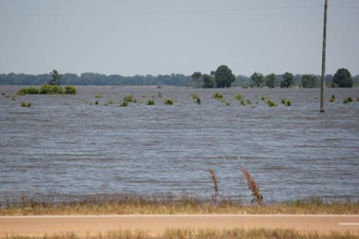
Roads Closed everywhere, farms under water.

Slide 13
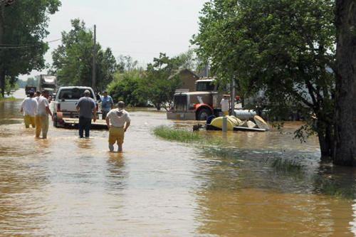
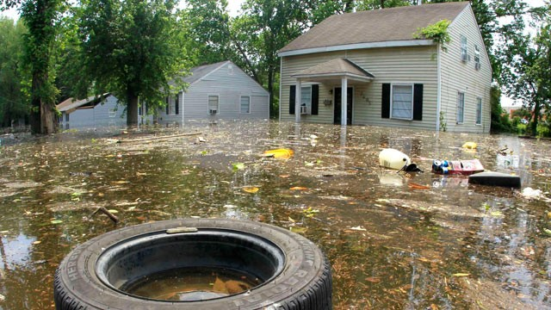
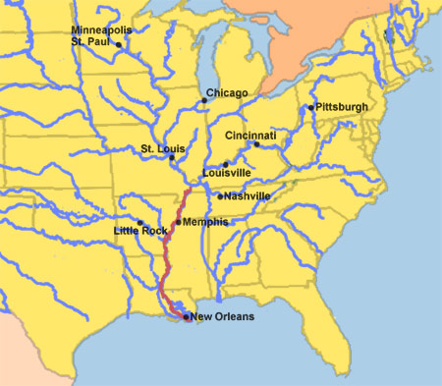
The U.S. Army Corps of Engineers said its plans to protect people from the Great Flood of 2011 worked.
Here are the rivers where flooding is occuring in 2011
http://www.youtube.com/watch?v=Xk2WmjxE97o
Flooding in Memphis
http://www.youtube.com/watch?v=aOzUG75u5AA&feature=related Davenport Iowa
http://www.youtube.com/watch?v=bkryCXvkiCw&feature=related Minneapolis MN

Slide 14
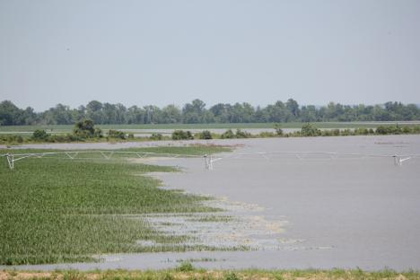
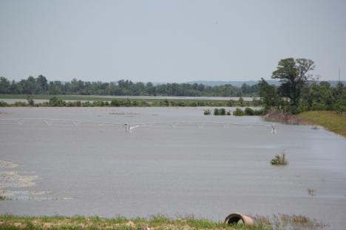
See the Pivot under water.
2011 Flooding,
Energy Issues,
Biotechnology,
Climate Change,
Pesticide Regulation,
Irrigation Systems,
Crop Insurance,
Plant bugs, Mites,
Grain Storage
Already a historic year for flooding, in coming weeks 2011 promises to place even more Mid-South homes, towns, roads and farms underwater.
“It looks like a sea with some trees sticking up out of it.”

Slide 15
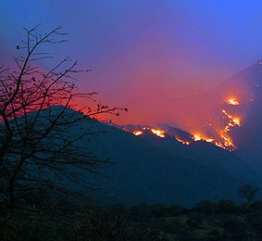
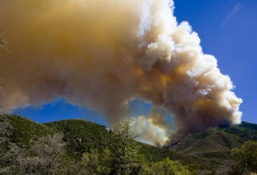
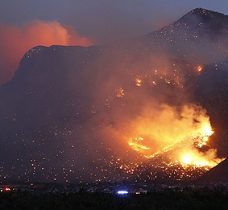
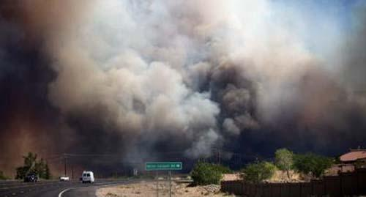
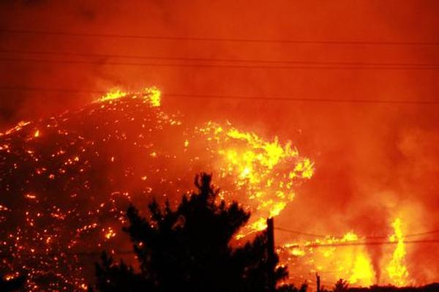
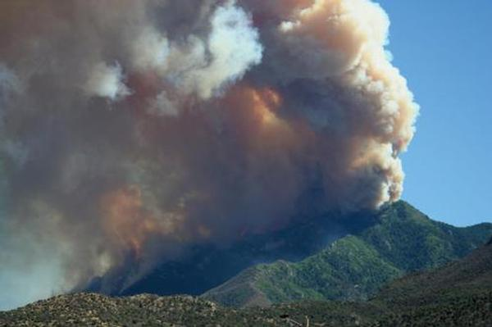
Monument and Garden fires AZ 2011
10, 000 evacuated homes.
Deaths…?

Slide 16
This is a warning:
Do you have a Bug-Out Bag?

Slide 17
http://www.youtube.com/watch?v=w3AdFjklR50 Japan Tsunami
Recommended Items to Include in a Basic Emergency Supply Kit:
Water, one gallon of water per person per day for at least three days, for drinking and sanitation
Food, at least a three-day supply of non-perishable food
Battery-powered or hand crank radio and a NOAA Weather Radio with tone alert and extra batteries for both
Flashlight and extra batteries
First aid kit
Whistle to signal for help
Dust mask, to help filter contaminated air and plastic sheeting and duct tape to shelter-in-place
Moist towelettes, garbage bags and plastic ties for personal sanitation
Wrench or pliers to turn off utilities
Can opener for food (if kit contains canned food)
Local maps
Cell phone with chargers, inverter or solar charger
Money
Insurance papers and credit cards.

Slide 18

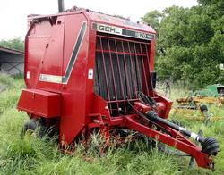
Heat adding to Georgia’s drought woes.
• Temperatures were above normal during May everywhere in Georgia for a fourth straight month.
• It was the ninth driest May in Savannah since records began in 1871, the seventh driest in Athens since 1857, the third driest in Columbus since 1948, and the fifth driest in Macon since 1892.
Equipment for sale everywhere.

Slide 19

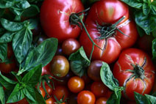
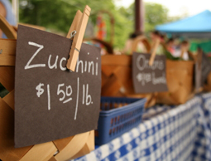
Since 1994, the number of farmers’ markets listed in the USDA National Farmers Market Directory has skyrocketed from 1,755 to 6,132. The directory captures information about where and when farmers’ markets operate, if they participate in federal nutrition-benefit programs, and detailed information about their seasonality and location.
Complete FMPP applications must be received—not postmarked—by AMS no later than close of business on July 1, 2011. Applications received after the deadline and incomplete applications will not be considered.
The 5,274 farmers' markets set up across the U.S. this year indicate an increasing consumer interest in buying local.
If you have clients in Farmers Markets, help them get their permits.

Slide 20


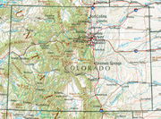
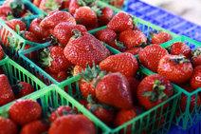
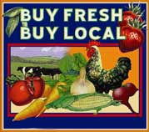
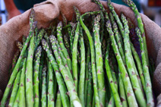

Apply Now! for a
Farmers Market Promotion Program Grant
http://www.gpo.gov/fdsys/pkg/FR-2011-06-01/html/2011-13483.htm

Slide 21

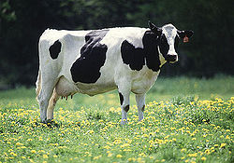
Dairy production is one of Colorado's top 10 agricultural sectors with approximately 115,000 dairy cows in the state.
June 20, 2011 07:51 PM Eastern Daylight Time
Governor John Hickenlooper Issues Proclamation, Commends Dairy Farmers for Contributions to Consumers, Communities
http://westerndairyassociation.org/dairy-farming-today/
Watch this youtube to see about this.

Slide 22
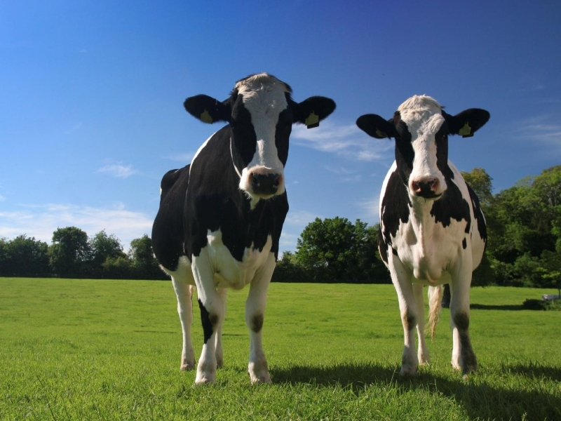
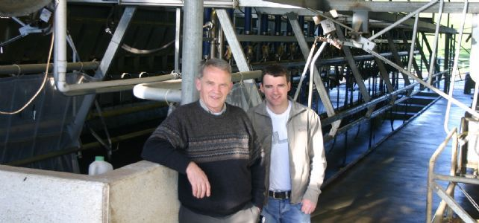
Buy your own cow and have it milked.
Robot Machines do the milking

Slide 23
So What new tax laws have changed for 2011 so far?..............
Lowers payroll tax – On incomes up to $106,800, there is a 2% reduction (from 6.2% to 4.2%) on an employee’s share of the Social Security portion of the FICA tax. For someone who makes $60,000, they could take home an additional $1,200 a year in 2011.
Extends 2001 – 2003 income tax cuts – On all incomes, the new tax law extends the Bush-era tax cuts. That means there will be no change in income tax rates 2011 – 2012.
The Child Tax Credit - This tax break will be extended for 2 years. It’s worth about $1,000 per eligible child, up to a $3,000 refundability threshold. The Child Tax Credit helps low and moderate income families to reduce their federal income tax by a certain amount for each qualifying child under age 17.
The Earned Income Tax Credit -The agreement continues a Recovery Act expansion of the Earned Income Tax Credit worth an average of $600 for families with 3 or more children, and reduces the “marriage penalty” faced by working married families.
The American Opportunity Tax Credit – The new American Opportunity Tax Credit would be continued. It’s a partially refundable tax credit that helps more than 8 million students and their families afford the cost of college.
Business Expensing – This will allow businesses to expense 100% of their investments in 2011. 50% expensing in 2012.
Extends unemployment for 13 months – Extends unemployment until January 2012, for those who qualify. Read more about the unemployment extension of 2010.
End

